Slide 1

Solar Irradiance Forecasting

Slide 2

Introduction
Proposing a unique three-module residual ensemble learning approach that includes data selection and analysis, correlation, and feature importance measures for feature selection, along with a residual ensemble learning model.
This innovative approach, combining advanced neural network architectures, is designed to predict future values of solar irradiance with significantly improved forecast performance.
Our exploration also delves into the development of forecast models using deep learning techniques with multiple-site data, focusing on predicting daily solar irradiance in various locations across India.
The overarching aim is to contribute substantially to the progress of solar energy applications and forecasting systems, placing a strong emphasis on optimizing the integration of solar energy into power grids.

Slide 3

Literature Review
LSTM-CNN Models:
The document highlights the utilization of deep long short-term memory-convolutional neural network (LSTM-CNN) models optimized by a modified whale optimization algorithm for forecasting solar irradiance datasets.
Ensemble Strategy:
An ensemble strategy based on a deep reinforcement learning algorithm is used to select the best of combined deep-optimized LSTM-CNN models for improved forecasting performance.
Deep Learning:
Deep learning techniques, including CNNs, RNNs, LSTMs, and attention models, have revolutionized various fields by enabling the automatic discovery of complex patterns and representations from raw data.

Slide 4

Problem Statement
Traditional linear methods are inadequate, prompting a model for precise predictions with both linear and non-linear capabilities.
Current methods neglect bias, impacting solar irradiance prediction reliability.
Limited accuracy and reliability, particularly in capturing short-term fluctuations and sudden changes in solar irradiance.

Slide 5



Reasearch gap
Research Gap
Integration of Chaos Models:
Limited exploration of chaos models in optimizing optimization processes, specifically in solar irradiance forecasting.
Efficiency of Tent Map Initialization:
Lack of utilization of the tent map for initializing population in evolutionary algorithms, particularly in solar energy optimization frameworks.
Hyperparameter Optimization Challenges:
Sparse research on optimizing hyperparameters of LSTM-CNN models using evolutionary algorithms like Modified Whale Optimization Algorithm (MWOA).
Ensemble Strategy Optimization:
Scarce investigation into reinforcement learning strategies, such as Q-learning, for selecting optimal subsets of LSTM-CNN models in ensemble forecasting.

Slide 6
Technical Implementation Insights:
Limited discussion on the technical implementation details, tools, and hardware specifications required for implementing solar irradiance forecasting frameworks.
Comparative Evaluation of Hybrid Models:
Insufficient comparative evaluation of the proposed HYDEREL framework against other hybrid models in the context of solar irradiance forecasting.
Visualization and Algorithmic Representation:
Absence of comprehensive visualization and algorithmic representation of the proposed methods in solar energy forecasting frameworks.

Slide 7

Objectives
Develop a hybrid predictive model combining linear and non-linear capabilities to enhance solar irradiance predictions, addressing bias neglect and traditional model limitations.
Integrate solar energy effectively by overcoming chaos associated with solar power fluctuations, ensuring precise and reliable irradiance predictions for efficient utilization.
Validate the model's effectiveness through comprehensive testing and comparison, providing actionable insights for stakeholders to advance renewable energy planning and management.

Slide 8
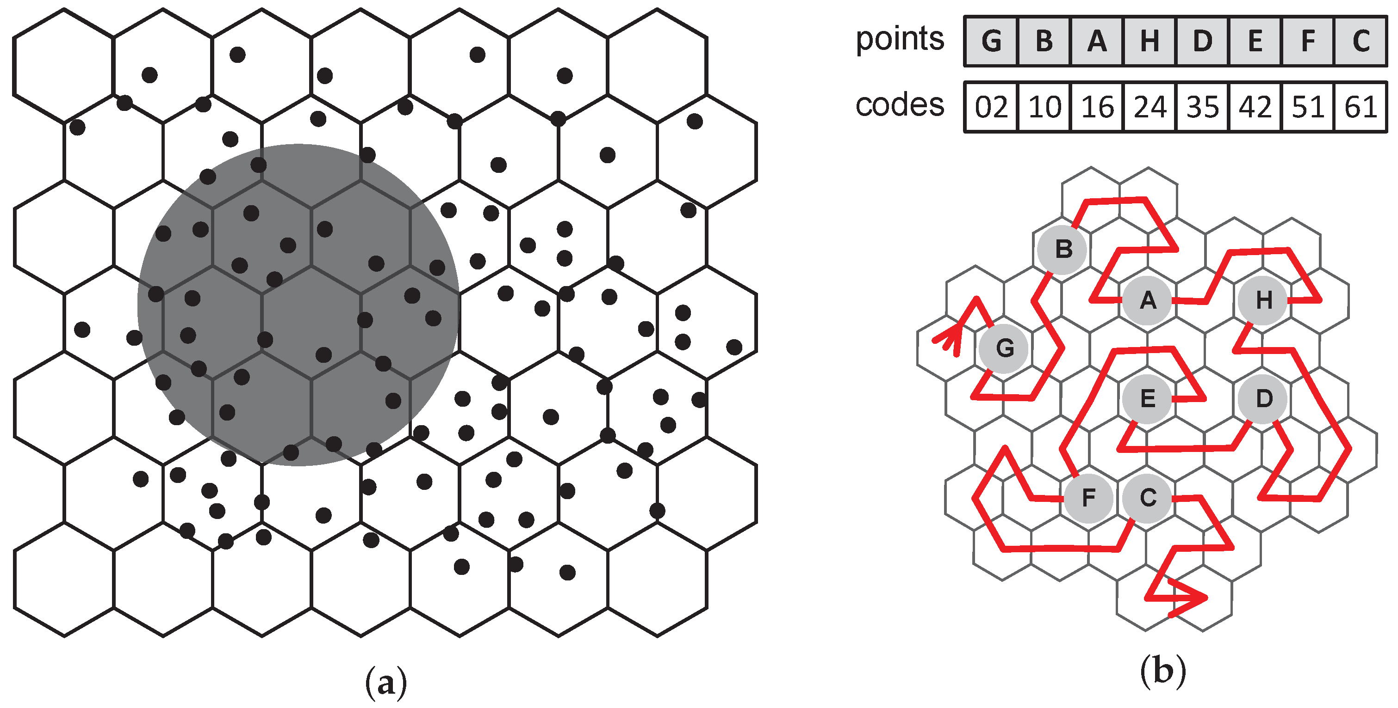
Proposed mechanism
Data from multiple sites surrounding the target location is analyzed using a hexagon gridding system. Correlation and feature importance help select relevant features. A novel residual ensemble forecast mechanism, blending linear and non-linear characteristics, is developed for accurate predictions.

Slide 9
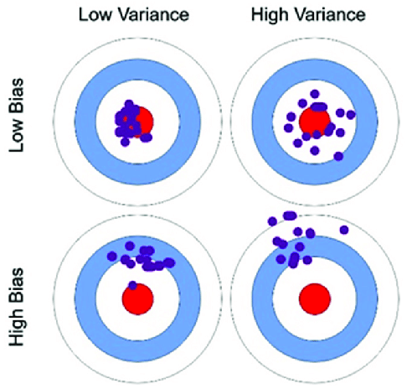
Solar irradiance data from the POWER project is visualized. A deep learning forecast model is developed, incorporating convolutional and attention-based LSTM layers. Bias and variance components are analyzed for model evaluation. Two solar datasets from selected locations are utilized for experiments, comparing against various deep learning models to ensure robust development and evaluation.

Slide 10

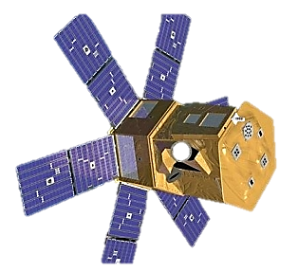
Collecting historical daily solar irradiance data from NASA's POWER project, to Develop deep learning forecast models with recurrent neural networks, convolutional neural networks, and attention mechanisms. Evaluating forecast performance using metrics like mean squared error, root-mean-square error, and coefficient of determination.

Slide 11
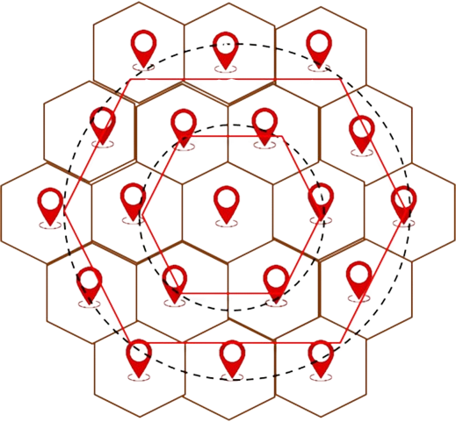
Hexagon Gridding System
Neighbour Selection Algorithm
Hexagon gridding ensures uniform coverage of the study area, minimizing gaps and overlaps in data collection.
This layout facilitates efficient data aggregation, enabling researchers to analyze large datasets systematically.
Hexagons are arranged in a grid pattern to represent spatial locations.
Each hexagon serves as a unit for data collection and analysis, offering a structured approach to spatial representation.

Slide 12
Feature Selection
Utilizing Correlation & Importance Scores
Correlation analysis assesses the relationship between input variables and solar irradiance.
Variables with high correlation coefficients are considered more influential in forecasting.
Calculate feature importance scores using machine learning models trained on historical data.
Prioritize variables that have the greatest impact on improving forecast accuracy.

Slide 13
Hybrid Forecast Mechanism
Linear & Non-linear Combination
Integrating both linear and non-linear modeling techniques to leverage their respective strengths.
Linear models capture simple relationships and trends, while non-linear models capture complex patterns and interactions.
Linear components: Linear regression, autoregressive models (AR), or moving average models (MA).
Non-linear components: Artificial neural networks (ANN), support vector machines (SVM), or decision trees.
Integration techniques: Weighted averaging, ensemble methods

Slide 14
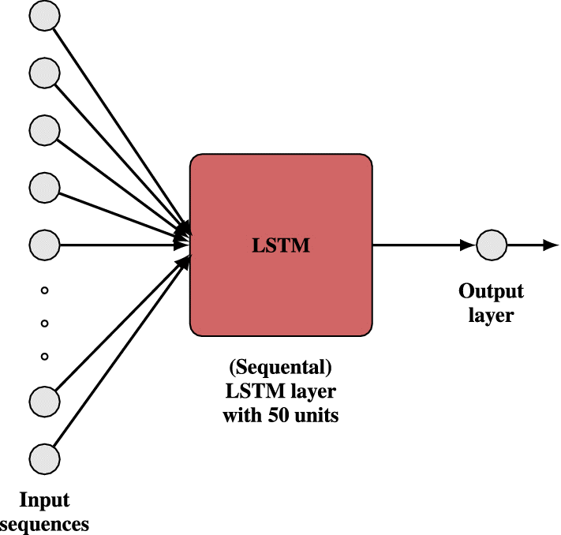
Model Architecture
Convolutional & Attention-based LSTM
The proposed model utilizes convolutional layers to extract internal representations from the input data.
This helps in capturing local patterns and features, improving the understanding of the images or sequences.
The attention-based LSTM network further adds the capability to identify temporal dependencies.
This allows the model to focus on specific parts of the input over time, enabling better predictions.

Slide 15

Accurate Solar Irradiance Prediction
Deep Learning Forecast
Neural Network Layers: Deep learning forecasting models typically consist of input, hidden, and output layers.
Recurrent Neural Networks (RNNs): RNNs are commonly used for time series forecasting, enabling the model to learn sequential dependencies in data.
End-to-end Learning: Deep learning models can directly learn from raw solar irradiance and meteorological data without requiring manual feature engineering.
Adaptability: Deep learning models can adapt to varying environmental conditions and geographical locations, enhancing their applicability for accurate solar irradiance prediction across diverse settings.

Slide 16
Data Set from POWER Project of NASA
The Prediction of Worldwide Energy Resource (POWER) project is an initiative by NASA to provide access to solar and meteorological data for renewable energy applications.
Solar Irradiance Data: Hourly, daily, and monthly solar irradiance measurements are available for various geographical locations worldwide.
Meteorological Parameters: In addition to solar irradiance, the dataset includes meteorological parameters such as temperature, humidity, cloud cover, and wind speed.
Spatial Coverage: The POWER dataset covers a wide range of latitudes and longitudes, providing comprehensive coverage for global solar energy assessment.

Slide 17
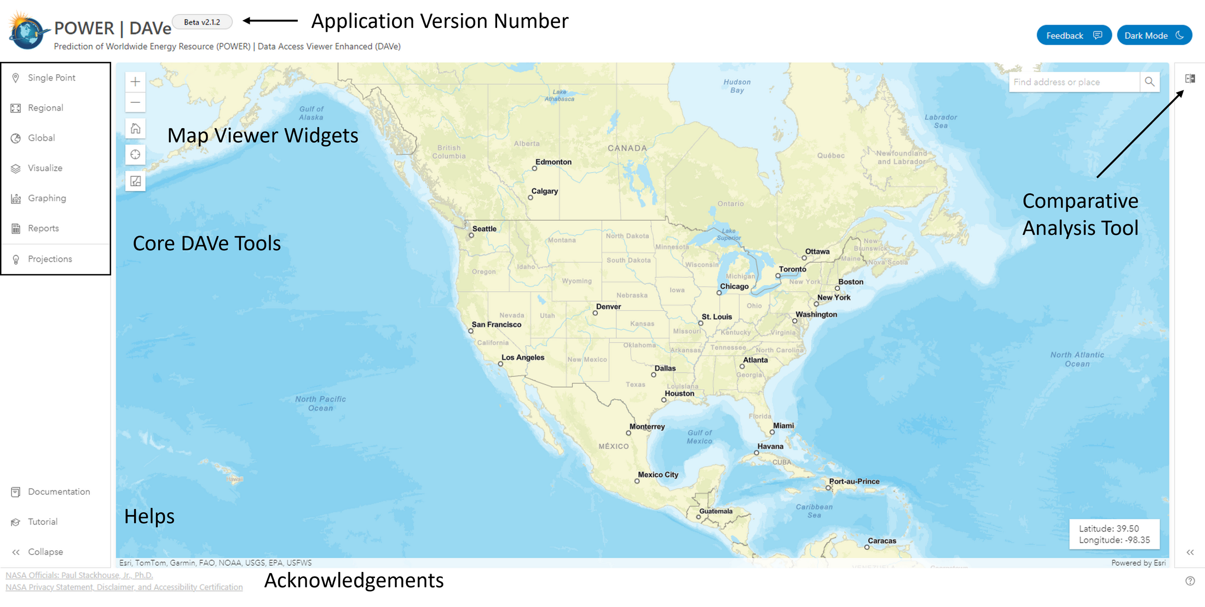
Data Set from POWER Project of NASA
Core DAV Tools : to download and interact with POWER data.
Map Viewer Widgets include interactive mapping functionality.
Application Version Number provides a snapshot in time and functionality.
Comparative Analysis Tool to visualize POWER data as layers in map

Slide 18



Results
Superior Accuracy: Our forecasting system outperforms baseline models and existing approaches, with lower MSE, RMSE, and MAE values.
Spatial Representation Enhancement: Hexagon gridding system improves spatial representation, enhancing prediction accuracy.
Innovative Forecast Mechanism: Residual ensemble approach blends linear and non-linear characteristics, leading to more accurate predictions.
Robust Deep Learning Models: Deep learning models with convolutional and attention-based LSTM layers demonstrate robust performance.

Slide 19

Conclusions
Utilizing multi-site data enhances solar irradiance forecasting, with the proposed residual ensemble learning approach improving prediction error.
Integrating convolutional and attention-based LSTM layers significantly enhances solar irradiance forecasting accuracy.
Bias-variance evaluation enhances model robustness and generalizability, making it valuable for real-world solar power plant planning and deployment.
The proposed methodology emphasizes accuracy, performance, and reliability, showing promising advancements in solar energy forecasting,

Slide 20
References
Brahma, B., & Wadhvani, R. (2023). A residual ensemble learning approach for solar irradiance forecasting. Multimedia Tools and Applications. Advanced online publication. https://link.springer.com/article/10.1007/s11042-023-14616-6
Brahma, B., & Wadhvani, R. (2021). Visualizing solar irradiance data in ArcGIS and forecasting based on a novel deep neural network mechanism. Multimedia Tools and Applications, 1197, Advance online publication. https://link.springer.com/article/10.1007/s11042-021-11025-5
Brahma, B., & Wadhvani, R. (2020). Solar irradiance forecasting based on deep learning methodologies and multi–site data. Symmetry, 12(11), Article 1826.

